Slide 1
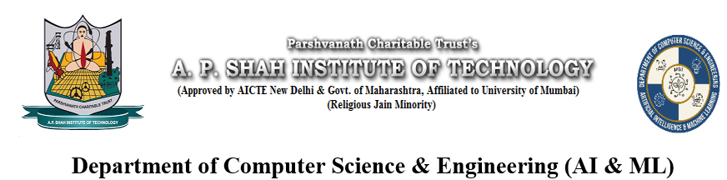
Protein Structure Property Predictor using GNNs
Ayush Bhandari (23106117)
Jayraj Dhole (23106114)
Project Guide
Prof.
Anushka Khandar (23106041)
Shaunak Das (23106002)

Slide 2
Introduction
Proteins play vital roles in biological processes like disease, metabolism, and drug interaction.
Knowing their properties (e.g., solubility, folding) is essential but hard to determine experimentally.
AI offers faster solutions — especially with Graph Neural Networks (GNNs) that capture structural relationships in proteins.
This project explores how GNNs can help predict key protein properties efficiently.

Slide 3
Problem statement
Predicting protein properties like solubility/folding is time-consuming and costly.
Sequence-based ML models miss spatial/structural info.
Proteins can be represented as graphs (amino acids =nodes, interactions = edges).
Graph Neural Networks (GNNs) can capture these relationships effectively.

Slide 4
Tech Stack
Python Libraries
PyTorch Geometric – GNN modeling
DeepChem – Bio-data preprocessing
Biopython – Handling biological data
RDKit – If you want to extract features from molecules
Types of GNNs: GCN, GAT, GraphSAGE
Libraries: PyTorch Geometric (PyG) or DGL

Slide 5
Technologies and Methodologies
Python – Programming language
PyTorch Geometric (PyG) – GNN implementation framework
DeepChem / Biopython – For protein data handling
Google Colab – Cloud-based training with GPU
Matplotlib / Seaborn – For results visualization
Protein Graph Construction
Nodes = Amino acids
Edges = Chemical bonds or spatial proximity
Graph Neural Networks (GNNs)
Model learns from protein graphs to predict properties
Supervised Learning
Trained on labeled datasets (e.g., solubility or folding class)

Slide 6
Contribution to Sustainable Development Goals (SDGs)
SDG 3 – Good Health and Well-being
Target 3.3 & 3.B: Fight diseases and promote R&D on vaccines and medicines.
Protein structure prediction is key in drug discovery.
Predicting solubility helps in designing bioavailable drugs.
Early detection of misfolded proteins may lead to insights into diseases like Alzheimer’s, Parkinson’s, and cancer.
Accelerates biological research pipelines, reducing time to cure.
SDG 9 – Industry, Innovation, and Infrastructure
Target 9.5: Enhance scientific research and foster innovation.
Uses cutting-edge AI techniques (GNNs) to solve biological problems.
Bridges biology + AI, which is the future of biotech startups, health tech, and R&D.

Slide 7
Thank You...!!

Slide 8
Conclusion

Slide 9
Implementation

Slide 10
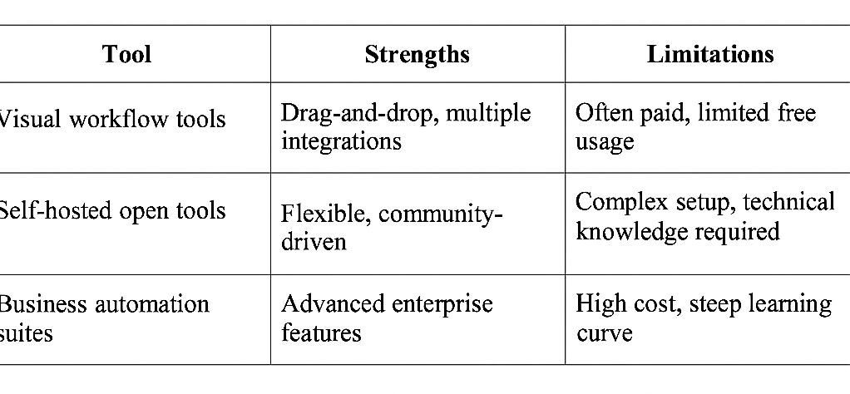
Literature Survey of the Existing System

